Slide 1
User Awareness & Training: Global Land Products for Regional Applications -Spain - Bucharest, Romania – 8th Nov 2013 GAF AG & EOMAP

Slide 2
Contents
Test Case: The use of COPERNICUS Global Land Products in Spain and by Junta de Andalusia
National dissemination of COPERNICUS Global Land data (products, necessary adaptations, applications, information dissemination)
Successful Applications / Test Cases:
Soil Erosion
Farm Management: Pasture Monitoring
Drought Monitoring: Water Availability / Snow Monitoring
Summary & Questions

Slide 3
Applications (Global for RS-Portal)
Context: General dissemination of Remote Sensing information is organised in a centralised way in Spain through a National Spatial Data Infrastructure (SDI)
Purpose: Remote Sensing Products and Services should be available through a central hub in a uniform way to all users in Spain with scientific and Spanish speaking support
Users: First level user on national level is the PNT (National Remote Sensing Network)

Slide 4
Applications (Global for RS-Portal)
Results:
Adapted (where necessary) Copernicus services and products available to Spanish Users
Support for take up of these services and products for regional and local level end users in Spain
Scientific advise on these RS products and services e.g. dedicated working group

Slide 5
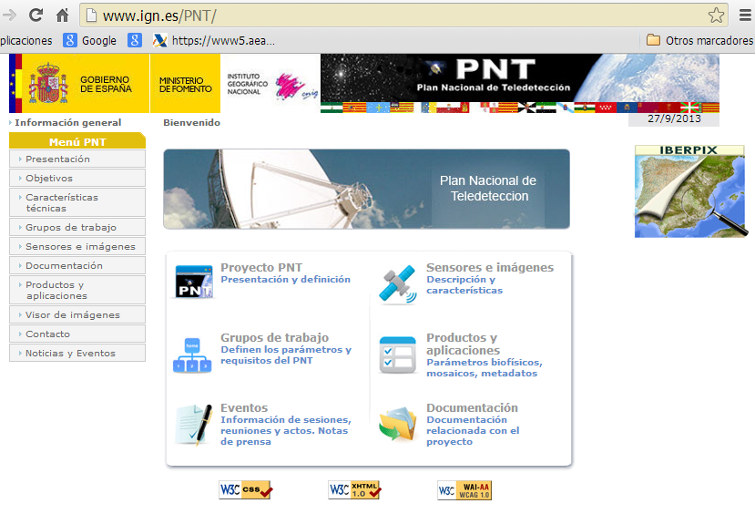
ES: National Remote Sensing Platform - PNT
PNT Web: http://www.ign.es/PNT/
Notes:
Dissemination of the COPERNICUS Global Land Products through the PNT National Remote Sensing Platform of Spain
Hosted by the Government of Spain / Ministry of Planning (National Geographic Institute)

Slide 6
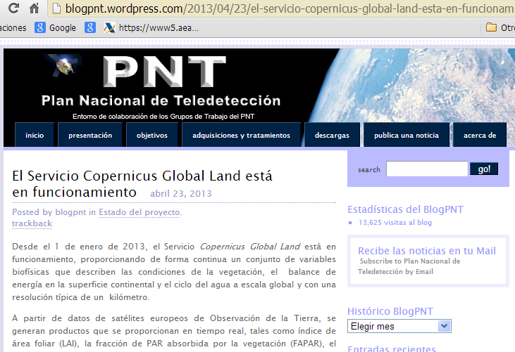
ES: National Remote Sensing Platform - PNT
PNT Blog:http://blogpnt.wordpress.com

Slide 7
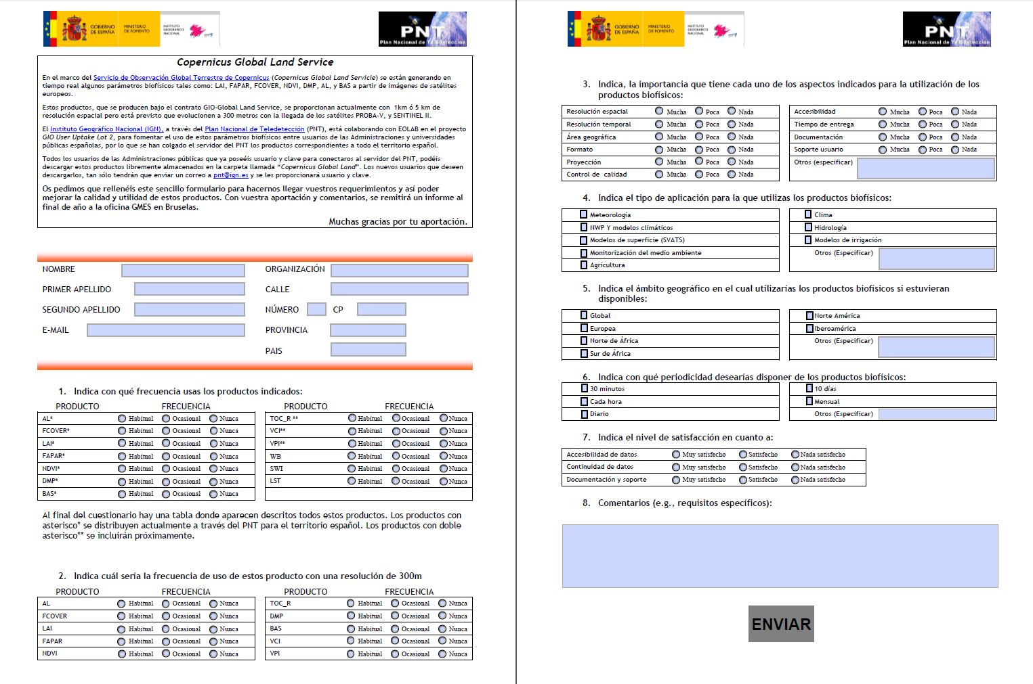
Registration for Data Request
Survey on Copernicus Global Land products

Slide 8
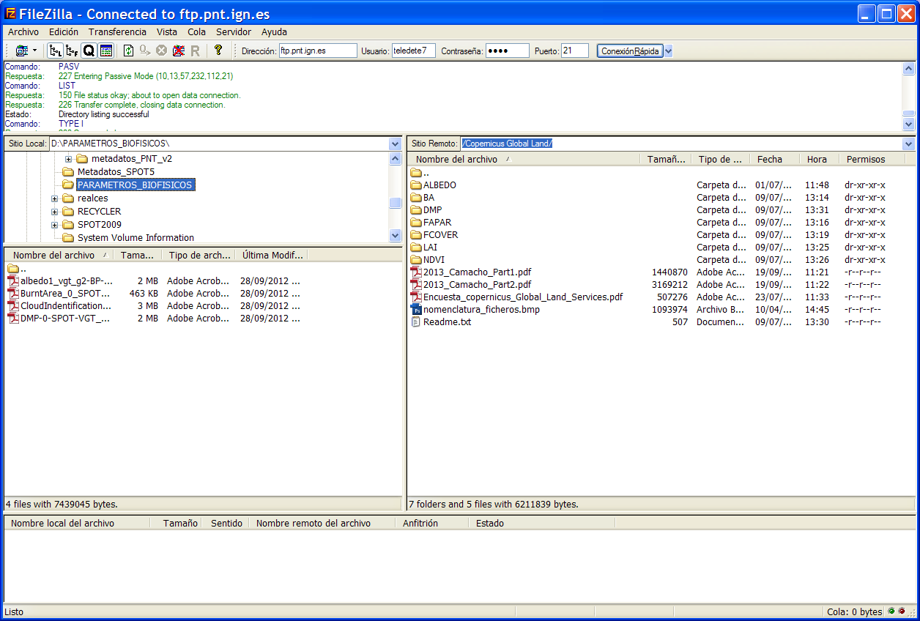
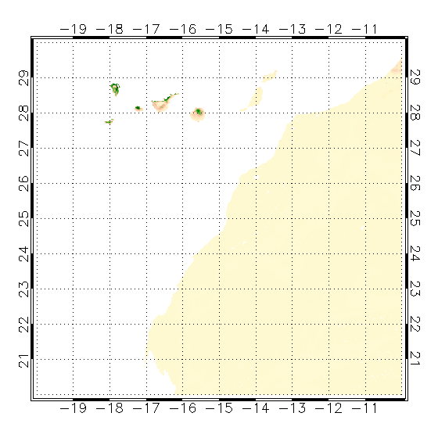
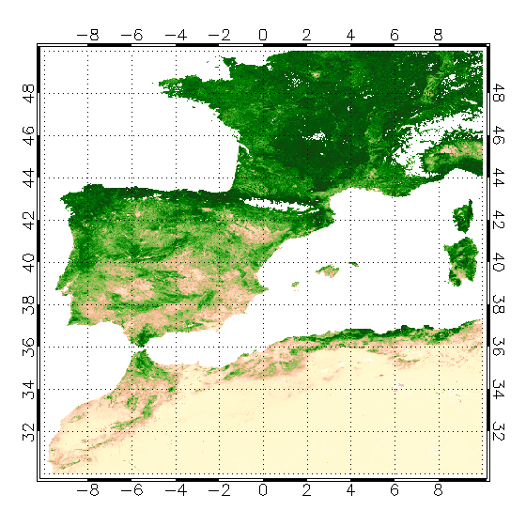
PNT – FTP download of GL products
COPERNICUS LAI products disseminated through PNT:
Coverage: Iberian Peninsula and Balearics Islands (Tiles: H17V4, H17V5, H18V4, H18V5), Canary Islands (Tile: H16V6).

Slide 9
Applications – Soil Erosion
Context: Soil Erosion is a key environmental problem in many countries, for soil fertility / agricultural productivity among other negative effects. Soil Erosion information is key information to combat soil erosion.
Purpose: The Junta de Andalusia / REDIAM is monitoring soil erosion using the USLE model. Additional information from RS-based products is implemented in the model.
Users: REDIAM is the Environmental Information Network of Andalusia monitoring environmental effects here Soil Erosion.

Slide 10
Applications – Soil Erosion
Results:
Improvement of the Soil Loss Model;
Cost reduction through use of GMES/COPERNICUS products and services;
Improved information generation as REDIAM is the focal point for env. reporting to EEA
Preliminary feedback of users:
Higher resolution of products favourable;
Easier and faster access to Copernicus products

Slide 11
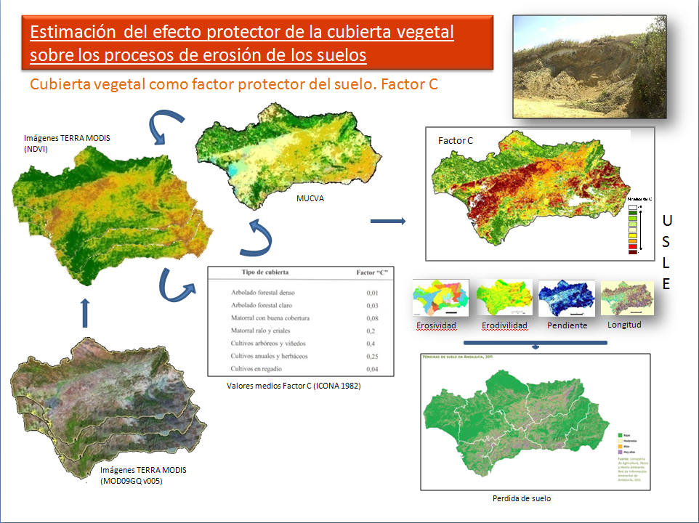
Soil Erosion Estimate (past)
Current operational procedure for soil erosion monitoring and Factor C estimation
Notes:
Factor C: cropping factor (e.g. tillage, coverage…)

Slide 12
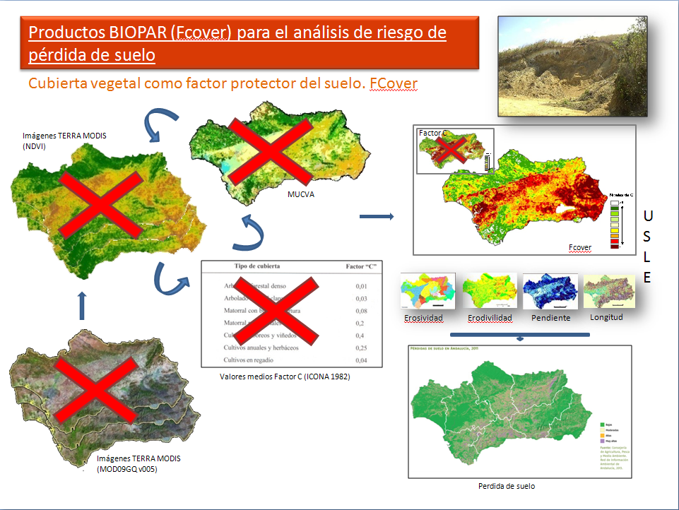
Soil Erosion Estimate (updated)
Flowchart of the Copernicus FCover product implementation into the soil erosion monitoring chain (crosses indicates removed products)
Notes:
Erosividad - Erosivity (rainfall erosivity - depends on intensity of rainfall)
Erodivilidad – Erodability (soil erodibility – depends on substrate and grain size)
Pendiente – Slope / steepness
Longitud - Slope length

Slide 13
Applications – Soil Erosion
Results:
Improvement of the Soil Loss Model;
Cost reduction through use of GMES/COPERNICUS products and services;
Improved information generation as REDIAM is the focal point for env. reporting to EEA
Preliminary feedback of users:
Higher resolution of products favourable
Easier and faster access to Copernicus products

Slide 14
Applications – Farm Management
Context: Drought and water availability are key factors in farm management and forage production. Information on drought, vegetation status and water availability are important for farm / cattle management to react in time on shortcomings
Purpose: The Junta de Andalusia / IFAPA is monitoring pasture / forage availability through dedicated models. COPERNICUS products are used to improve the models and hence improve information and advise for farmers
Users: IFAPA is the Institute for Research and Education for Agriculture and Fishery (under CAPMA) providing research and advice for farms, agro-industries and administrations in Andalusia

Slide 15
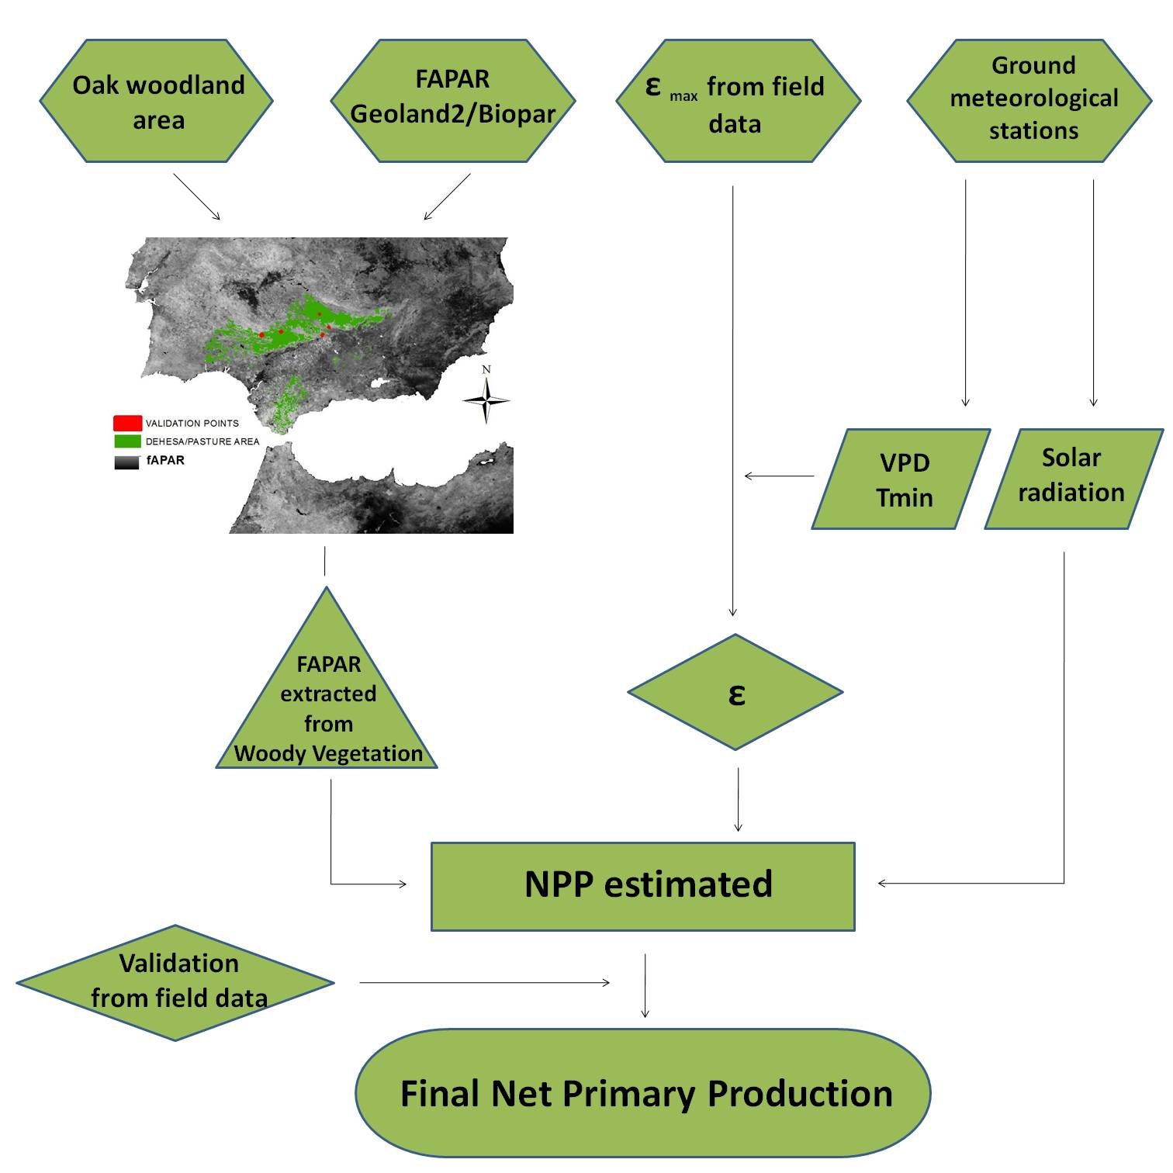
Farm Managment - Pasture Monitoring
Flowchart of the implementation for pastures monitoring
Using an adaptation of Monteith model (1977) for biomass production
NPP (g/ha): net primary production
PAR (MJ): photosynthetically active radiation
ε (g/MJ): the efficiency in the use of light
COPERNICUS - FAPAR (dimensionless): fraction of photosynthetically active radiation absorbed by vegetation

Slide 16
Applications - Farm management
Results:
Improvement of forecast and monitoring systems
Improvement of advise and information for farmers, agroindustries and administrations
Cost reduction of the service through use of COPERNICUS products and services
Preliminary feedback of users:
Higher resolution of products favorable but
COPERNICUS data is an improvement now

Slide 17
Applications - Drought Monitoring
Context: Drought and water availability are important factors for water management. Information on snow melt timeline and spatial distribution support water management and environmental protection
Purpose: The Junta de Andalusia / IFAPA is monitoring water sheds in the National Park Sierra Nevada for improved water management
Users: IFAPA is the Institute for Research and Education for Agriculture and Fishery (under CAPMA) providing information forecast and monitoring for Watermanagment in Andalusia

Slide 18
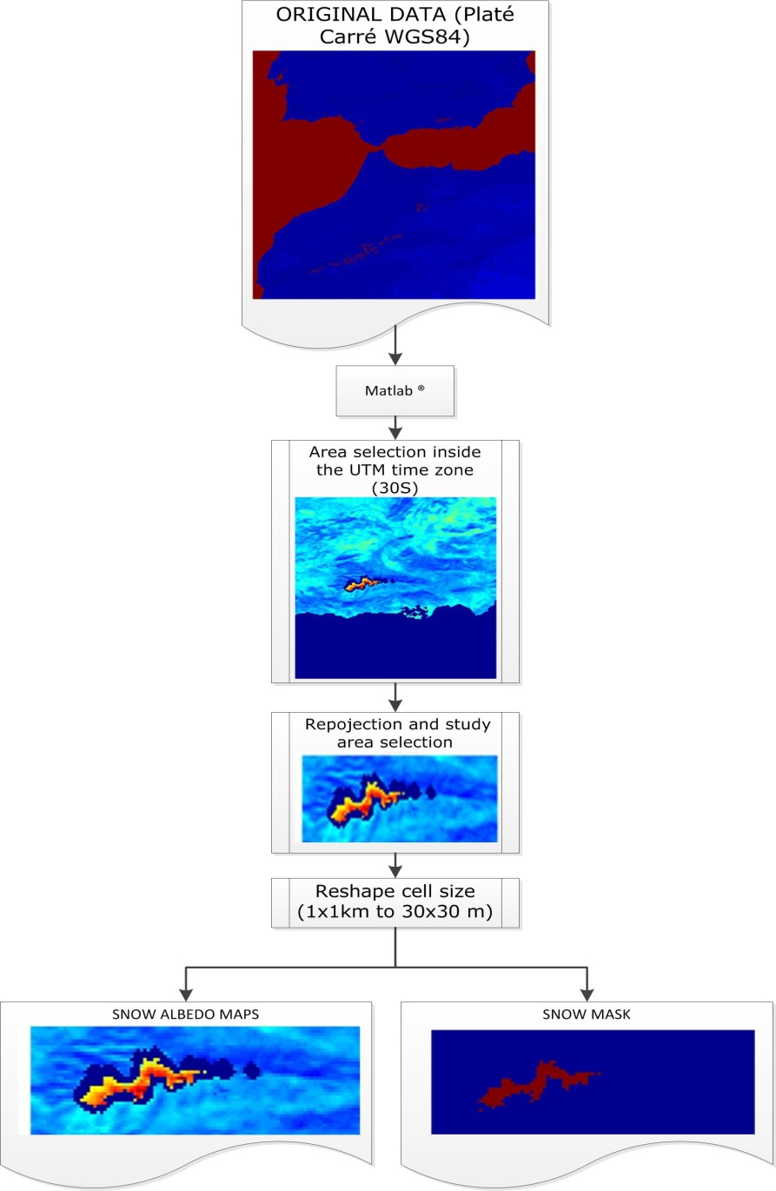
Application: Drought/Snow Monitoring
Hydrological model WiMMed (Watershed Integrated Management in Mediterranean Environments)
Required cell size 30x30 m² derived from available GLOBAL LAND products (1x1 km²)

Slide 19
Snow Monitoring Simulations
Simulation 1: WiMMed simulation using as input a homogenous snow albedo value over the snow pixels.
Simulation 2: WiMMed simulation using as input snow albedo patterns obtained by a previous analysis with Landsat images.
Simulation 3: WiMMed simulation using a Direct Insertion technique in which the Copernicus data are assimilated into the modeling.

Slide 20
Applications (Drought Monitoring)
Results:
Improvement of spatial snow melt events after winter
Improved water managment on watershed level
Cost reduction of the service through use of GMES/COPERNICUS products and services
Preliminary feedback of users:
Easier access to Copernicus products (water bodies for Europe will be helpful)
NRT data access favorable
Higher resolution helpful

Slide 21
Test case summary and experience
Summary and experience:
In general the data is helpful, but it must be tailored and adapted to national needs (projections, formats…)
For most applications, much higher resolutions are needed (30mx30m optimum)
Scientific and technical advise on COPERNICUS-RS products and services is necessary and
Support in national languages necessary for uptake (coordinated national involvement needed)

Slide 22
Feedback Forms
&
Questions
Notes:
Feedback forms will be distributed and people will be encouraged to complete them in this time.
Open floor up to questions.

